Slide 1


Java Basics
Archer Infotech , PUNE
AMOL – 98222 91613
www.archerinfotech.in

Slide 2
Java Strings

Slide 3
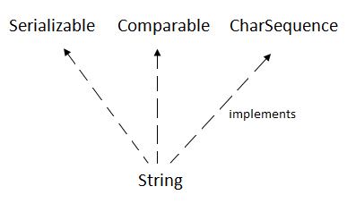
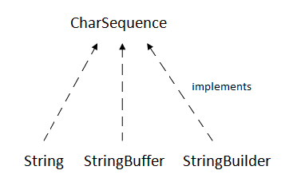
String
String is Sequence of Characters represented as an Object
The CharSequence interface is used to represent the sequence of characters
The Java String is immutable which means it cannot be changed. Whenever we change any string, a new instance is created. For mutable strings, you can use StringBuffer and StringBuilder classes.

Slide 4
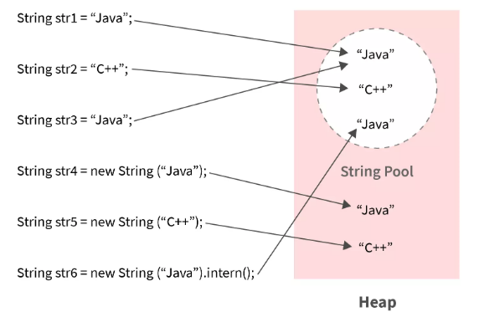
String Pool

Slide 5
String Pool
Sting is immutable in Java.
All Strings are stored in the String Pool (or String Intern Pool) that is allocated in the Java heap.
String pool is an implementation of the String Interring Concept.
String Interning is a method that stores only a copy of each distinct string literal.
The distinct values are stored in the String pool.
String pool is an example of the Flyweight Design Pattern.
We can use intern() method to put it into the pool or refer to another String object from the string pool having the same value

Slide 6
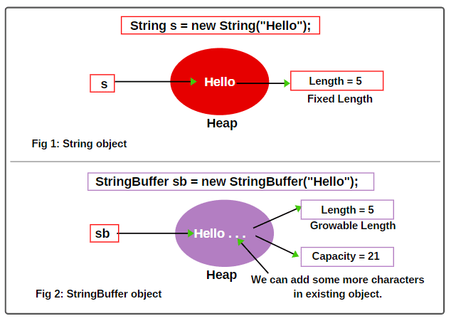
StringBuffer class
Java StringBuffer class is used to create mutable (modifiable) String objects. The StringBuffer class in Java is the same as String class except it is mutable i.e. it can be changed.
Capacity: The total number of characters hold in the StringBuffer object is called capacity.
New capacity =
( Current capacity + 1 ) * 2
Thus, New capacity = (16 + 1) * 2 = 34

Slide 7
StringBuffer class
StringBuffer in java is used for storing mutable sequences that increase their efficiency.
The object of StringBuffer in java is thread safe multiple threads cannot access the StringBuffer particular object simultaneously.
StringBuffer is fastest than the String class due to the mutable property of the StringBuffer class.
The default capacity of the StringBuffer in java is 16 bytes.
StringBuffer is mostly used when we perform several dynamic addition operations. We cannot use the String class because it will cause a lot of memory waste due to the immutable property of the String class.

Slide 8
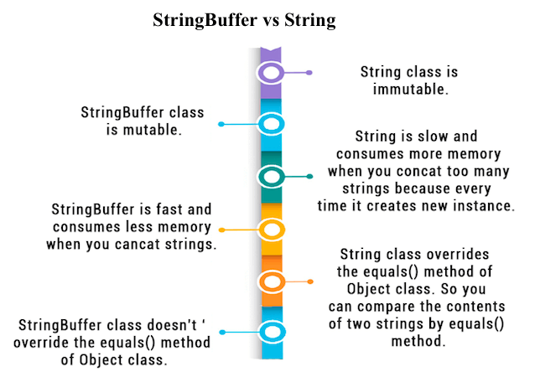
String vs. StringBuffer

Slide 9
StringBuilder
Java StringBuilder class is used to create mutable (modifiable) String.
The Java StringBuilder class is same as StringBuffer class except that it is non-synchronized.
It is available since JDK 1.5.

Slide 10
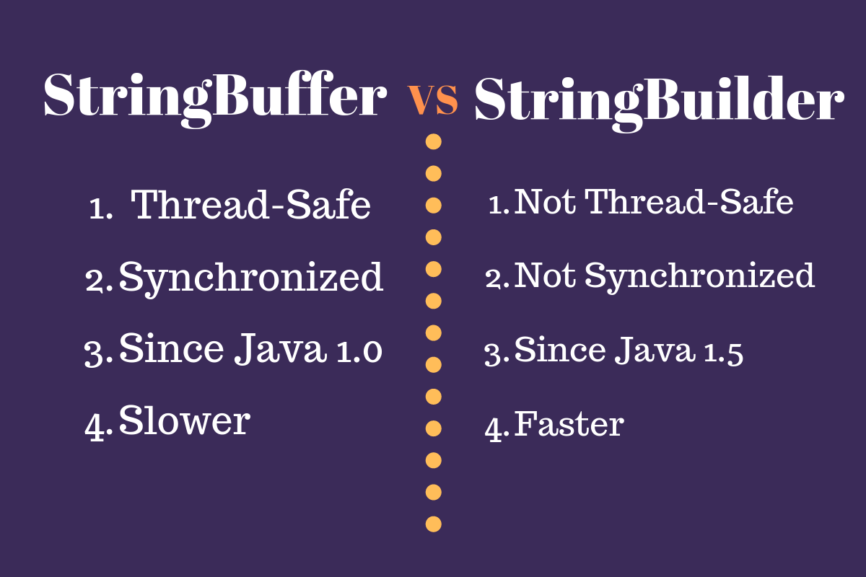
StringBuilder vs. StringBuffer

Slide 11
THANK YOU !!!
AMOL - 9822291613

